Slide 1




Artificial Neural Networks (Introduction))

Slide 2
Contents
Pigeons as Art Experts
Neural Networks Introduction
How do our brains work?
Features of Neural Networks
Why Neural Networks?
Biological Neuron vs Artificial Neuron (Perceptron)
Perceptron Model
A Single Artificial Neuron…
Artificial Neural Network (ANN)
Types of ANN
Learning ANN
Gradient Descent Method
Backpropagation
Resilient Backpropagation

Slide 3
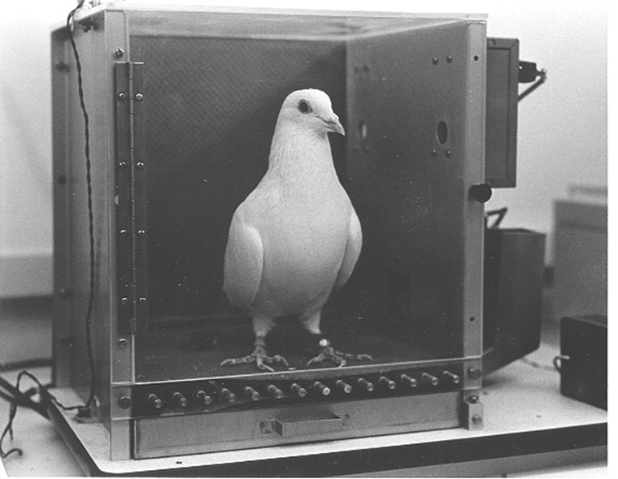
Pigeons as Art Experts
Experiment:
Pigeon in Skinner box
Present paintings of two different artists (e.g. Chagall / Van Gogh)
Reward for pecking when presented a particular artist (e.g. Van Gogh)
Pigeons were able to discriminate between Van Gogh and Chagall with 95% accuracy (When presented with pictures they had been trained on).
Discrimination still 85% successful for previously unseen paintings of the artists.

Slide 4
Pigeons as Art Experts
Pigeons do not simply memorize the pictures They can extract and recognise patterns (the ‘style’) They generalize from the already seen to make predictions
This is what neural networks (biological and artificial) are good at (unlike conventional computer).

Slide 5
Neural Networks Introduction
Artificial neural network (ANN) is a machine learning approach that models human brain and consists of a number of artificial neurons.
Each neuron in ANN receives a number of inputs.
An activation function is applied to these inputs which results in activation level of neuron (output value of the neuron).

Slide 6
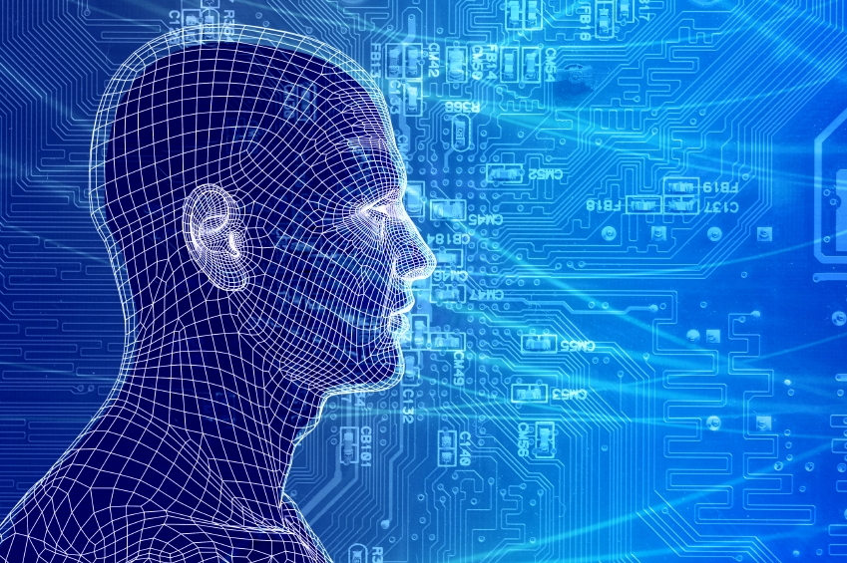
How do our brains work?
The Brain is a massively parallel information processing system. Our brains are a huge network of processing elements. A typical brain contains a network of 10 billion neurons.

Slide 7
Features of Neural Networks
Massive connectivity
Nonlinear, Parallel, Robust and Fault Tolerant
Capability to adapt to surroundings
Ability to learn and generalize from known examples
Collective behaviour is different from individual behaviour
Artificial Neural Networks mimics some of the properties of the biological neural networks

Slide 8
Why Neural Networks?
There are two basic reasons why we are interested in building artificial neural networks (ANNs):
Technical viewpoint:
Some problems such as character recognition or the prediction of future states of a system require massively parallel and adaptive processing.
Biological viewpoint:
ANNs can be used to replicate and simulate components of the human (or animal) brain, thereby giving us insight into natural information processing.

Slide 9
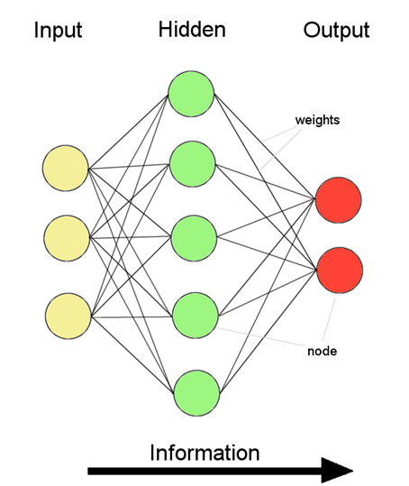
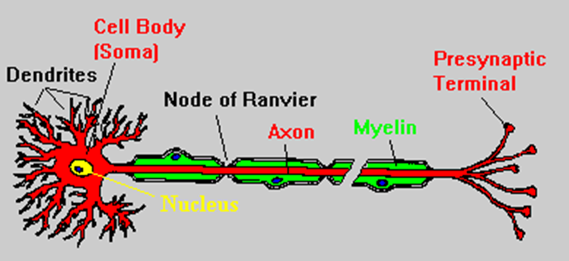
Biological Neuron vs Artificial Neuron (Perceptron)
Information flow is unidirectional
Data is presented to Input layer
Passed on to Hidden Layer
Passed on to Output layer
Information is distributed
Information processing is parallel
Network function f: R3 {0, 1}2
Biological Neuron

Slide 10
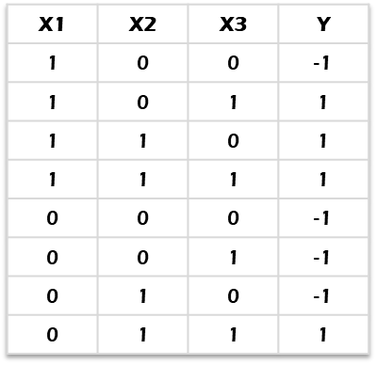
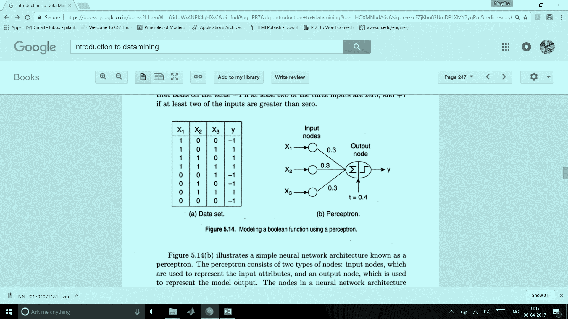
Perceptron Model
Consider data with 3 Boolean variables X1, X2, X3 and an output variable y
Data Perceptron
y {
-1, if 0.3 X1 + 0.3 X2 + 0.3 X3 – 0.4 > 0;
1, if 0.3 X1 + 0.3 X2 + 0.3 X3 – 0.4 < 0.
Perceptron consists of two types of nodes: input nodes which is used to represent the attributes, and output node which is used to represent the model output.
Perceptron computes its output value, by performing a weighted sum on its inputs, subtracting a bias factor t from the sum, and then examining the sign of the result.

Slide 11
A Single Artificial Neuron…
Input
xm
. . . . . . . . . . . .
x2
x1
Processing
∑
∑= X₁+X₂ + ….+X_{m} =y
Output
y

Slide 12
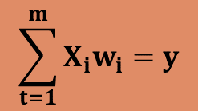
A Single Artificial Neuron…
Input
xm
x2
x1
. . . . . . . . . . . .
Weights
w_{m}
w₂
w₁
Processing
∑
∑= X₁w₁+X₂w₂ + ….+X_{m}w_{m} =y
Output
y
$$\sum_{t=1}^{m}{X_{i}w_{i}=y}$$

Slide 13

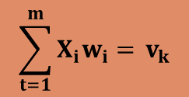
A Single Artificial Neuron…
Input
xm
x2
x1
Weights
w_{m}
w₂
w₁
Processing
∑
$$\sum_{t=1}^{m}{X_{i}w_{i}=} v_{k}$$
Transfer Function (Activation Function)
f(v_{k})
Output
y
$$y_{k}=f(v_{k})$$

Slide 14
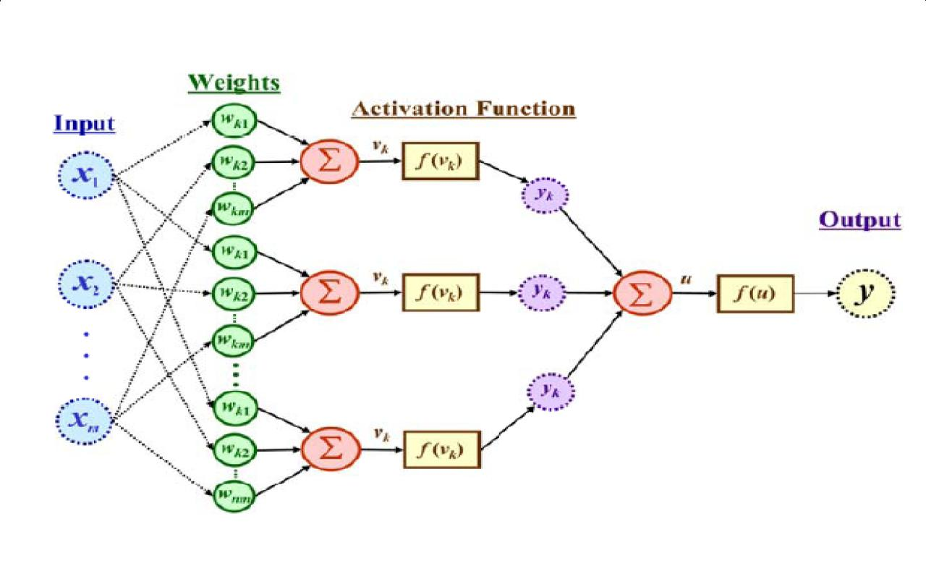
The output is a function of the input, that is affected by the weights, and the transfer functions

Slide 15
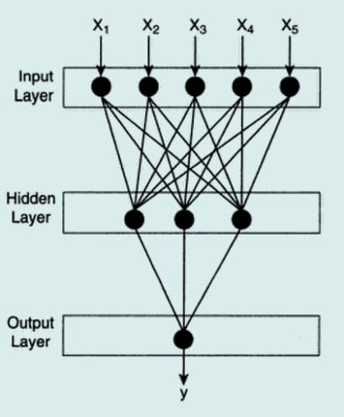
Artificial Neural Network (ANN)
A neural network is more complex than a perceptron model in multiple ways.
Network may contain several intermediary layers between its input and output layers which are called hidden layers and the nodes embedded in these layers are called hidden nodes. This restructuring is known as a multilayer neural network.
In a feed forward network, nodes in one layer are connected to nodes in the next layer.
In a recurrent network, the links may connect nodes within the same layer or from one layer to the previous layers.

Slide 16
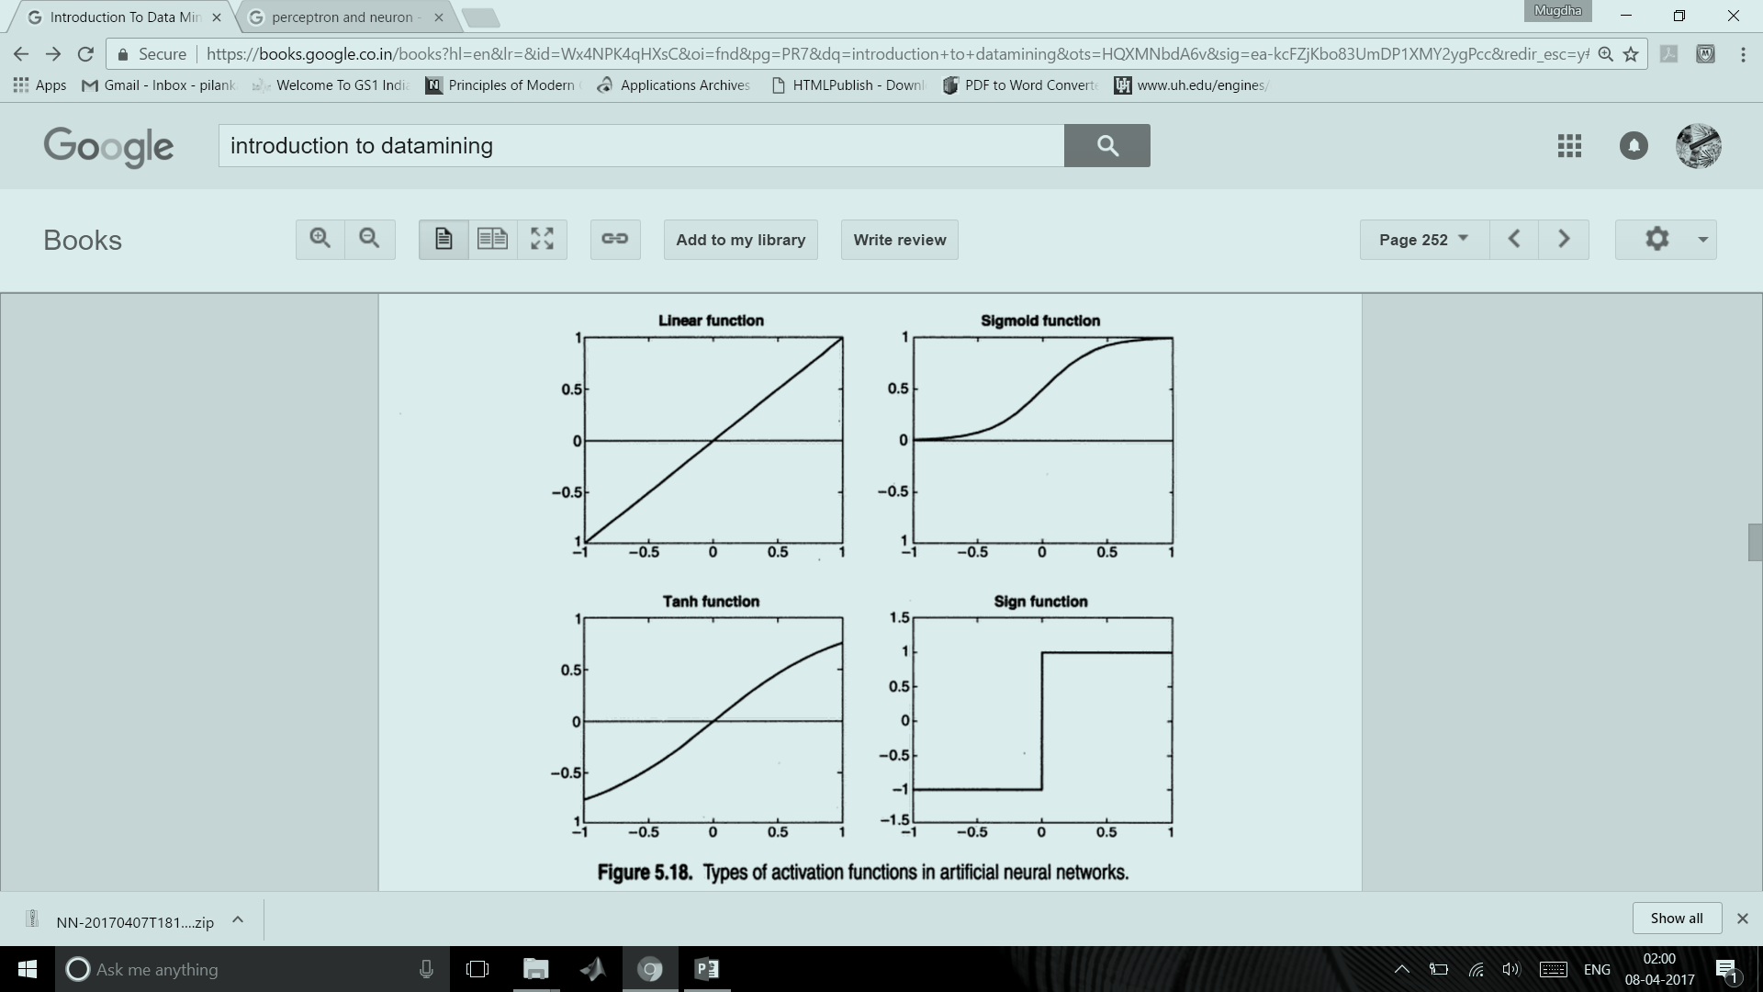
Types of ANN
The artificial neural network may use types of activation functions other than sign function. Examples of other activation function include linear, sigmoid, and hyperbolic tangent functions.
These additional complexities allow multilayer neural networks to model more complex relationships between the input and output variables.

Slide 17
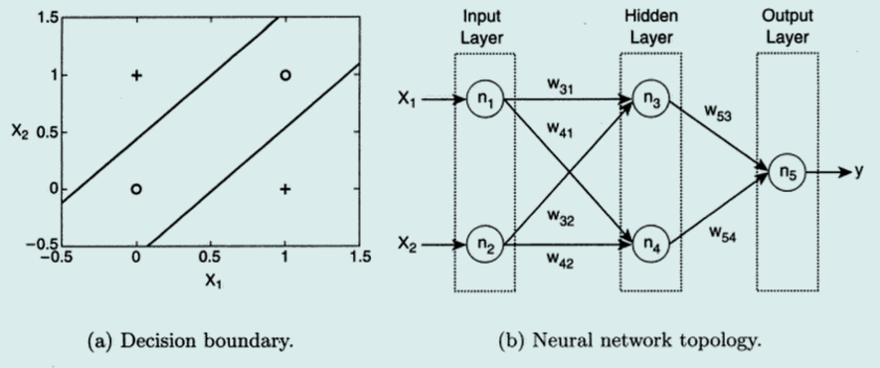
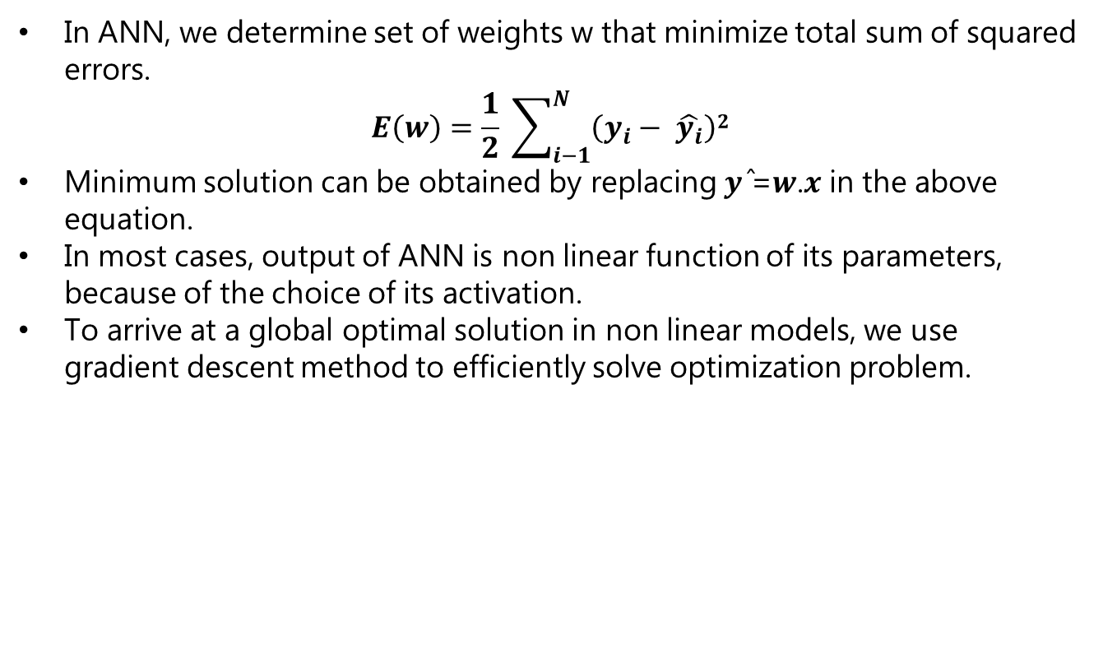
Learning ANN
In ANN, we determine set of weights w that minimize total sum of squared errors.
$$E\left(w\right)=\frac{1}{2} \sum_{i−1}^{N}{\left(y_{i}− \hat{y_{i}}\right)2}$$
Minimum solution can be obtained by replacing 𝒚 ̂=𝒘.𝒙 in the above equation.
In most cases, output of ANN is non linear function of its parameters, because of the choice of its activation.
To arrive at a global optimal solution in non linear models, we use gradient descent method to efficiently solve optimization problem.

Slide 18
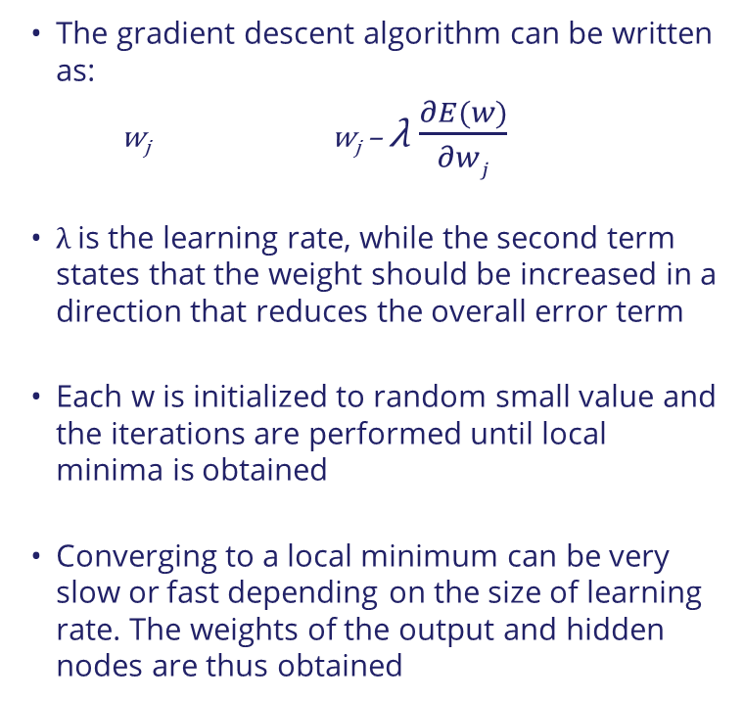
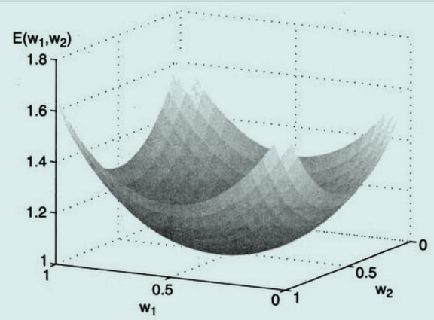
Gradient Descent Method

Slide 19
Backpropagation
In case of hidden nodes, computation becomes complex and error term cannot be assessed without prior information of weights. Back propagation method can be used which works in 2 phases – forward and backward.
During forward phase, we compute output value of each neuron in the network using previous iteration weight. The computation progresses in the forward direction, outputs at the neuron k are computed prior to computing the outputs at level k+1.
In backward phase, weight update formula is applied in the reverse direction, i.e. weights at level k+1 are updated before weights at level k.
This backward propagation approach allows us to use errors for neurons at layer k+1 to estimate the errors for neurons at layer k.

Slide 20
Resilient Backpropagation
Compared to the traditional back propagation algorithm, the Resilient propagation (rprop) algorithm offers faster convergence and is usually more capable of escaping from local minima.
Rprop is a first-order algorithm and its time and memory requirement scales linearly with the number of parameters.
Resilient propagation does not take into account the value of the partial derivative (error gradient), but rather considers only the sign of the error gradient to indicate the direction of the weight update.
In practice, Rprop is easier to implement than BPNN.

Slide 21
Quick Recap
Neural Networks
Artificial neural network (ANN) is a machine learning approach that models human brain and consists of a number of artificial neurons.
In a feed forward network, nodes in one layer are connected to nodes in the next layer.
In a recurrent network, the links may connect nodes within the same layer or from one layer to the previous layers.
In ANN, we determine set of weights w that minimize total sum of squared errors.
To arrive at a global optimal solution in non linear models, we use gradient descent method to efficiently solve optimization problem.
In case of hidden nodes, we use backpropagation. The Resilient propagation (rprop) algorithm offers faster convergence than traditional backpropagation.

Slide 22
THANK YOU!

